Slide 1
Deep Learning Optimization: Impact of Optimizers strategies

Slide 2
Agenda
Introduction
Problem definition
methodology
results
visuals

Slide 3
Introduction
SGD, Momentum-based, Adaptive Optimizers

Slide 4
Problem
Choosing the right optimizer for the task

Slide 5
Optimizers
SGD
Stochastic Gradient Descent
Momentum
Momentum-based SGD
ADAM
Adaptive Moment Estimation
We will be discussing 3 of the most popular optimizers
Each solving a problem with the last and improving upon it
Discussing each one will help us answer the question from earlier

Slide 6
Methodology

Slide 7
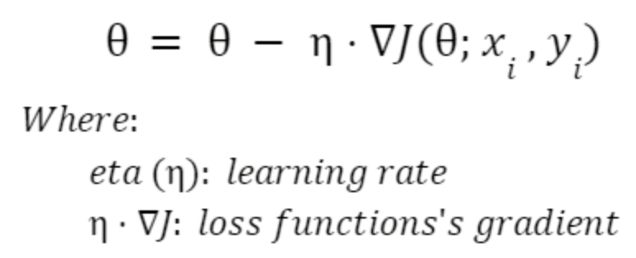
Stochastic Gradient Descent (SGD)

Slide 8
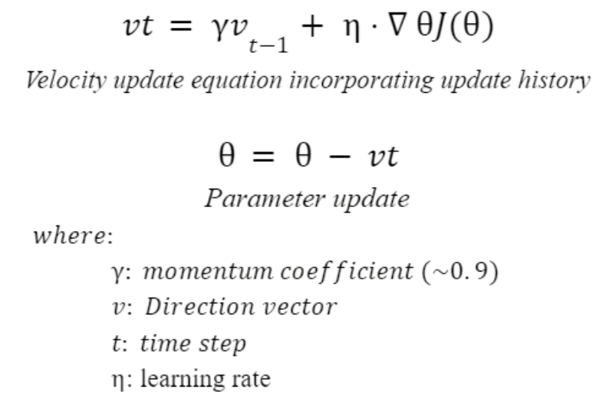
SGD with Momentum

Slide 9
Adaptive Moment (ADAM)
Adaptive Gradient + RMSprop + Momentum = Adam

Slide 10
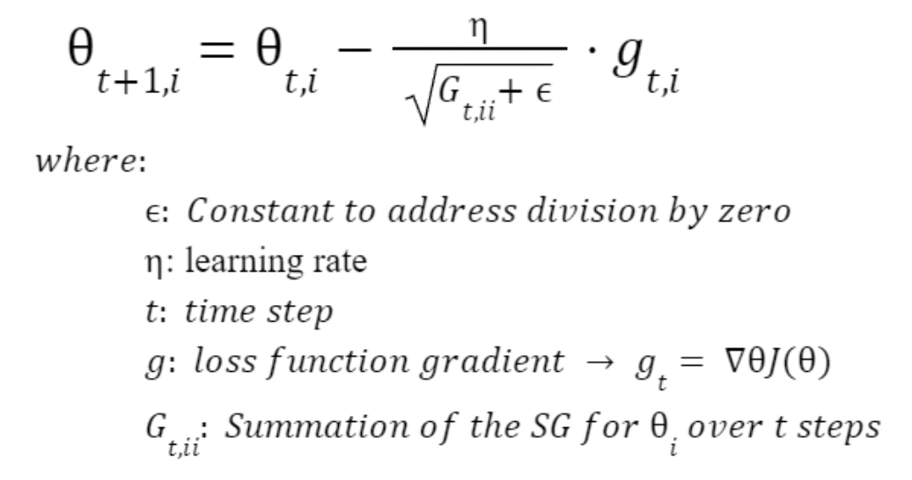
Adaptive Gradient (AdaGrad)

Slide 11
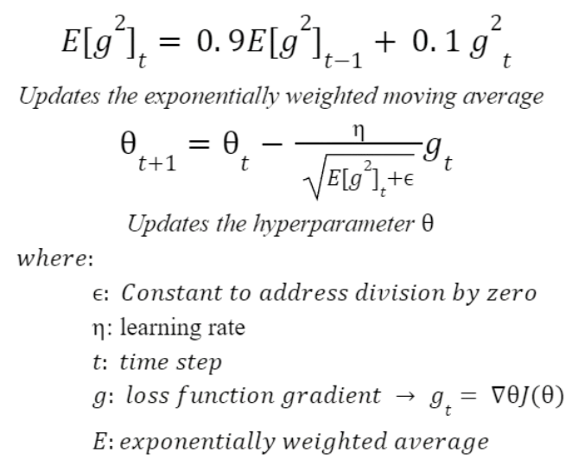
Root Mean Square propagation (RMSprop)

Slide 12
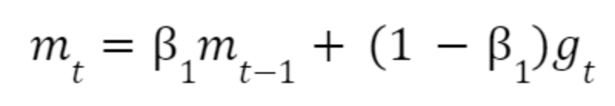
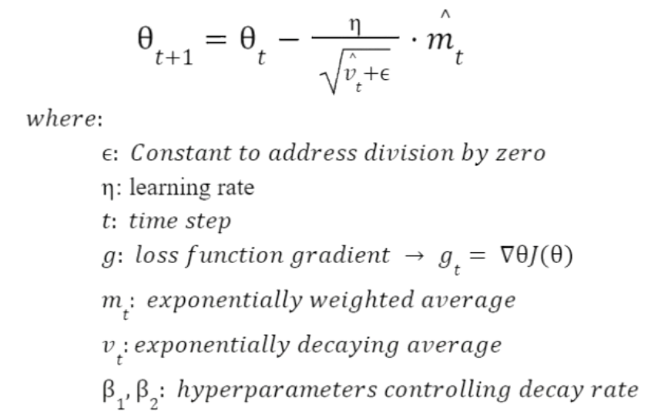
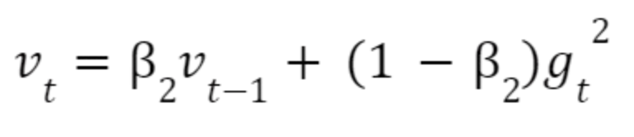
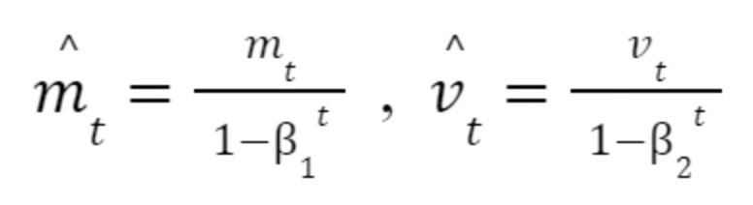
Merging The Techniques

Slide 13
Results & Comparisons

Slide 14
Tensorflow Vs Custom Opt.
A comparison between from scratch optimizers with the built in optimizers offered in the python Tensorflow library
Optimizer | Custom Acc. (%) | Tensorflow Acc. (%)
SGD | 94.68 | 95.24
SGD w/ Momentum | 97.58 | 97.91
Adam | 97.56 | 97.96

Slide 15
Visualization

Slide 16
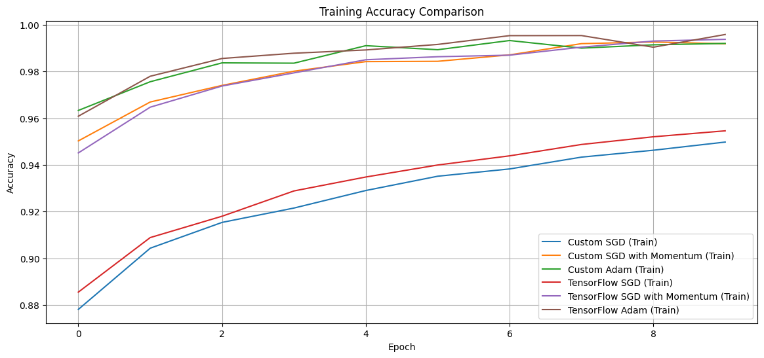
Training Accuracy

Slide 17
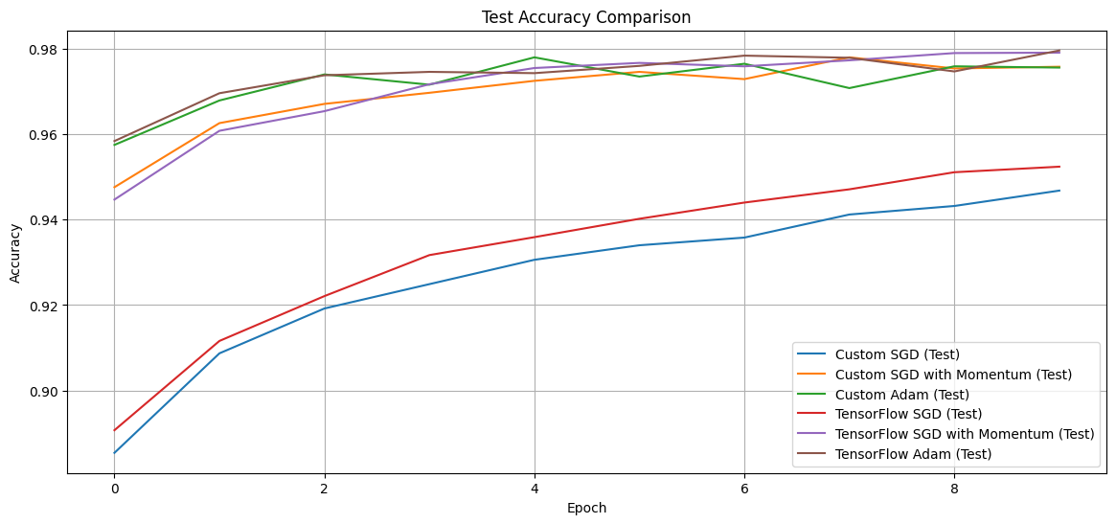
Testing Accuracy

Slide 18
More Interactive Visuals …
Check out the Notebook!

Slide 19


Want the full code?

Slide 20
References
Bock, S., Goppold, J., & Weiß, M. (2018, April 27). An improvement of the convergence proof of the ADAM-Optimizer. arXiv.org. https://arxiv.org/abs/1804.10587
Bushaev, V. (2018, June 21). Stochastic Gradient Descent with momentum - Towards Data Science. Medium. https://towardsdatascience.com/stochastic-gradient-descent-with-momentum-a84097641a5d
Cutkosky, A., & Mehta, H. (2020, November 21). Momentum improves normalized SGD. PMLR. https://proceedings.mlr.press/v119/cutkosky20b.html
Goodfellow, I., Bengio, Y., & Courville, A. (2016). Deep learning. MIT Press.
Learning optimizers in deep learning made simple. (2024, October 28). ProjectPro. https://www.projectpro.io/article/optimizers-in-deep-learning/983
Optimizers: Maximizing accuracy, speed, and efficiency in deep learning. (2024, June 25). CloudThat Resources. https://www.cloudthat.com/resources/blog/optimizers-maximizing-accuracy-speed-and-efficiency-in-deep-learning
S. Boyd and L. Vandenberghe, Convex Optimization. Cambridge, UK: Cambridge University Press, 2004.
“SGD with Momentum Explained,” Papers with Code. [Online]. Available: https://paperswithcode.com/method/sgd-with-momentum [Accessed: Dec. 31, 2024]
Ruder, S. (2016, September 15). An overview of gradient descent optimization algorithms. arXiv.org. https://arxiv.org/abs/1609.04747
"Optimization: Stochastic Gradient Descent," CS231n: Convolutional Neural Networks for Visual Recognition, Stanford University. [Online]. Available: https://cs231n.github.io/optimization-1. [Accessed: Dec. 31, 2024].
11.J. Brownlee, "Adam Optimization from Scratch," Machine Learning Mastery. [Online]. Available: https://machinelearningmastery.com/adam-optimization-from-scratch. [Accessed: Dec. 31, 2024].

Slide 21
Thank you

